Slide 1
1- Fundamental of GANs
Risman Adnan Mattotorang
Software R&D Director
Samsung R&D Institute Indonesia

Slide 2
Welcome to Data Science Center UI
What You Will Learn Today
Introduction to Generative Models
Overview Generative Adversarial Networks
Deep Convolutional GAN
Conditional GAN
What You Will Practice Today
Setup Your GAN experiment (Collab, PyTorch)
Create Your First GAN
DCGAN Model
Conditional GAN Model

Slide 3
Outline
Introduction to Generative Models
Generative Adversarial Networks (GANs)
Deep Convolutional GANs
Conditional GANs

Slide 4
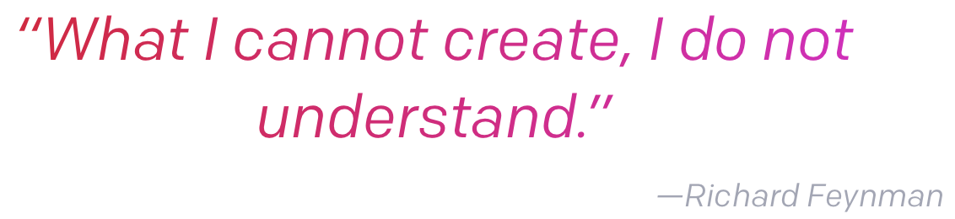
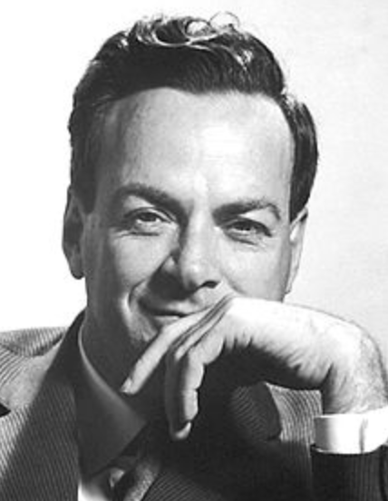
Generative vs Discriminative Model
Discriminative Model
Learn hypothesis function that map input data (x) to some desired output class label (y). In probabilistic terms, learn the conditional distribution P(y|x).
Generative Model
Learn the joint probability of the input data (x) and labels simultaneously, i.e. P(x,y). This can be converted to P(y|x) for classification via Bayes rule.
Generative model can learn to create new sample data (x,y).

Slide 5
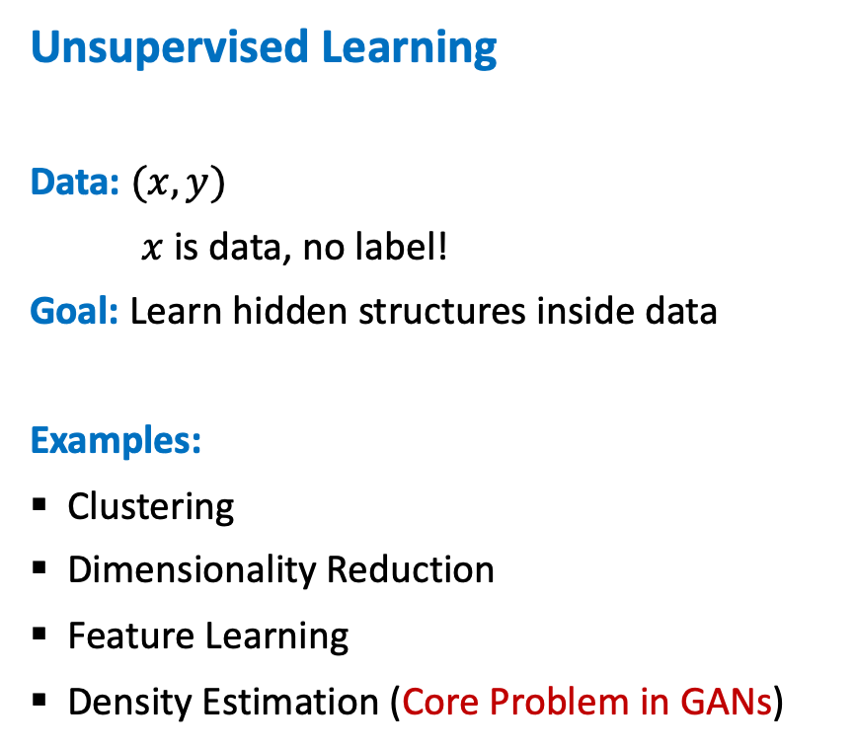
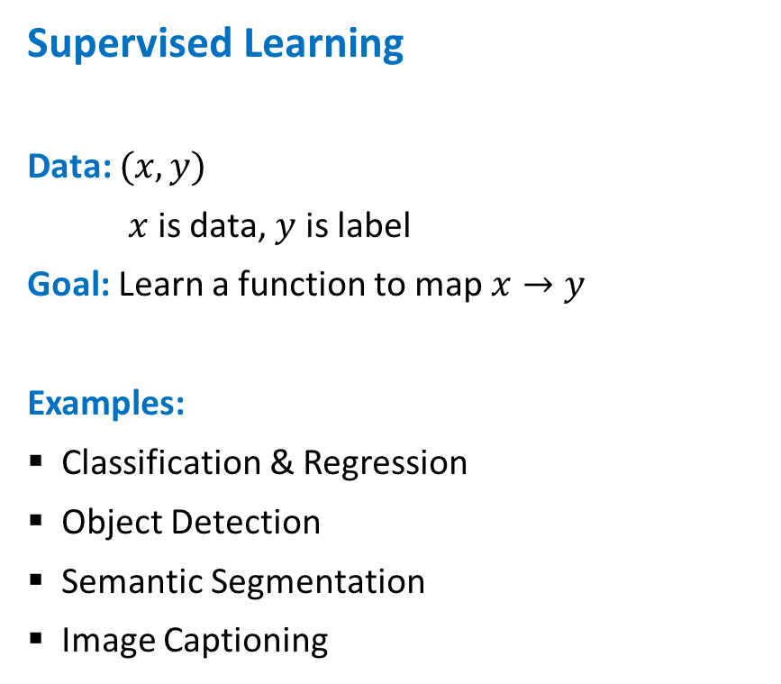
Supervised vs Unsupervised Learning
Supervised Learning
Data: $(x,y)$
$x$ is data, $y$ is label
Goal: Learn a function to map $x→y$
Examples:
Classification & Regression
Object Detection
Semantic Segmentation
Image Captioning
Unsupervised Learning
Data: $(x,y)$
$x$ is data, no label!
Goal: Learn hidden structures inside data
Examples:
Clustering
Dimensionality Reduction
Feature Learning
Density Estimation (Core Problem in GANs)

Slide 6
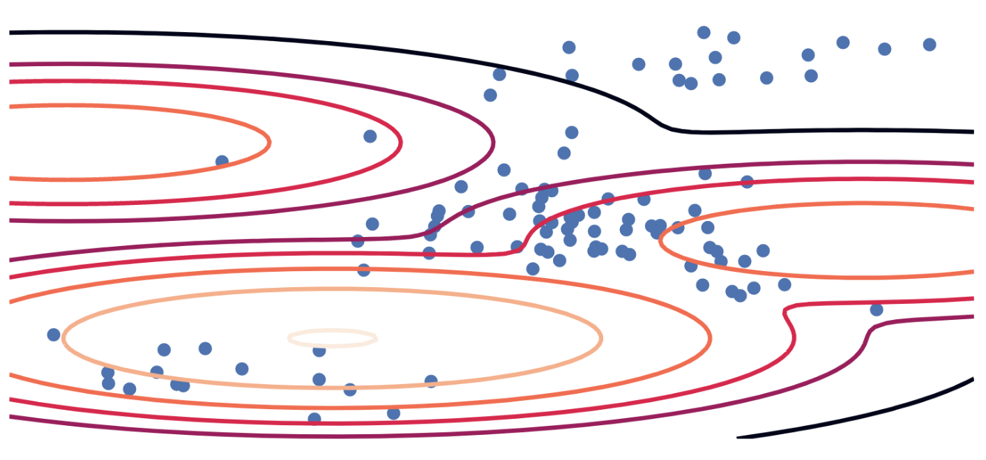
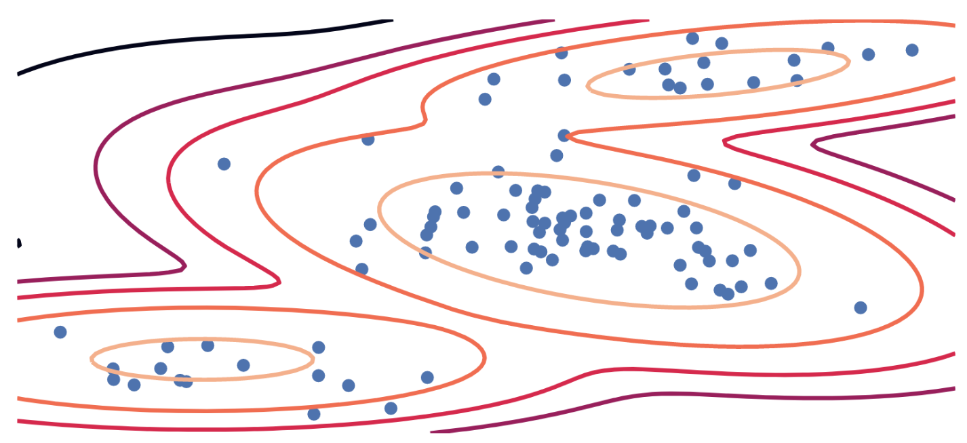
Generative Models: A Traditional Explicit Way
Fit Model
Training Data:
Given $\left\{x\right\}\sim p$ (known$X$, unknown $p$)
Maximum Likelihood (MLE):
$$\max_{θ} 𝔼_{X\sim P}[log q_{θ}(X)]$$
Parametric Model:
Distribution $q_{θ}(x)$ (known $q$, unknown $θ$)
Equivalent to KL Divergence:
$$\min_{θ} KL\left(P∥Q_{θ}\right)=\min_{θ}\int{p\left(x\right)\log{\frac{p(x)}{q_{θ}(x)}dx}}$$

Slide 7
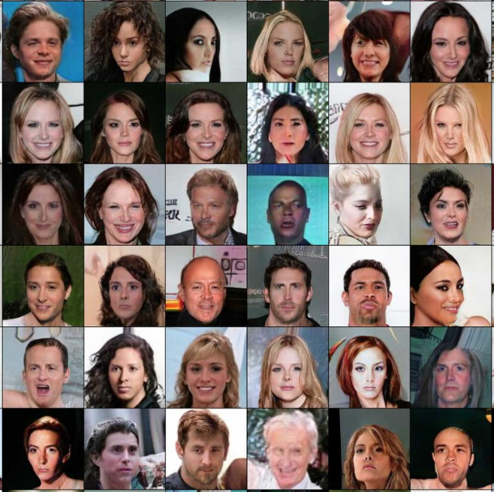
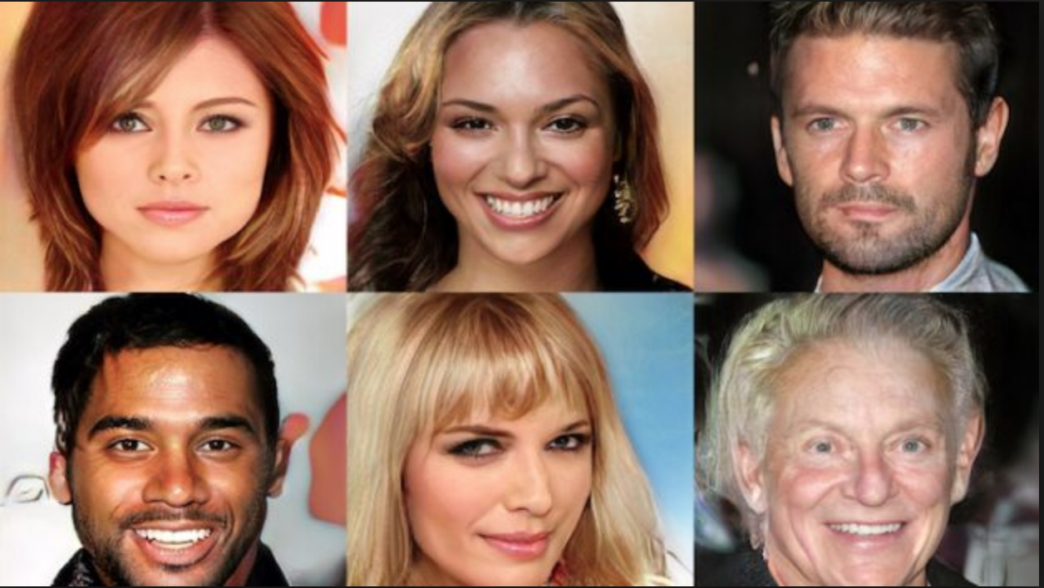
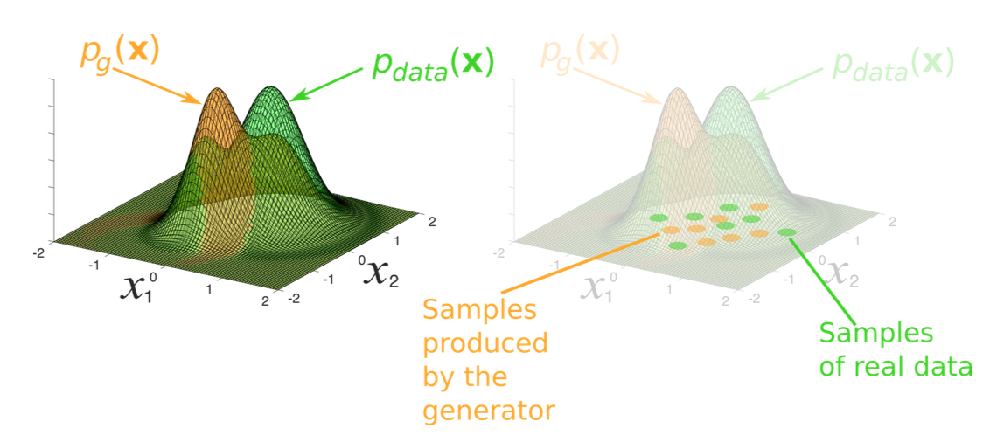

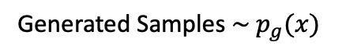
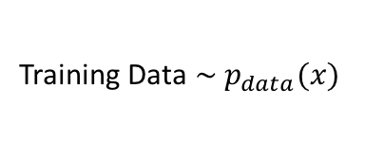
Generative Models
Problem: Given training data, generate new samples from same distribution.
Goal: We want to learn $p_{g}(x)$ similar to $p_{data}(x)$. Learn about data through generation.
Addresses density estimation, a core problem in unsupervised learning
Explicit Density: Explicitly define and solve for $p_{g}(x)$
Implicit Density: Learn model than can sample from $p_{g}(x)$ without explicitly define it
Training Data $\sim p_{data}(x)$
Generated Samples $\sim p_{g}(x)$

Slide 8
Why Generative Models Important?
Advantages of Generative Models:
Represent and manipulate high-dimensional probability distribution
Can be incorporated into (inverse) reinforcement learning in several ways
Can be trained with missing data on semi-supervised learning
Can provide predictions on inputs that are missing data
Enable machine learning to work with multi-modal outputs
Many tasks intrinsically require realistic generation of samples from some distributions:
Creating Art and Realistic Images
Single Image Super-Resolution
Image-To-Image Translation
What I cannot create, I do not understand!
-- Richard Feynman

Slide 9
Applications of Generative Models
Computer Vision | Speech Recognition | Natural Language
Realistic Image Creation | Generative Speech Enhancement | Realistic Text Generation
Image-to-Image Translation | Speech Driven Animation | Text Translation
Synthetic Image Creation | Lips Talking and Reading | Text Corpora Generation
Image and Shape In-Painting | Synthetic Audio/Voice | Generative Machine Translation
Object/Image Reconstruction | Voice Conversion | Conditional Sequence Generation
Image Super-Resolution | Voice Separation | Neural Dialog Generation
Face Emotion and Aging | Voice Impersonation | Generative Conversation Responses
Video Frame Prediction | Speech and Speaker Emotion | Text Style Transfer
Video Deblurring | Postfilter for Synthesized speech | Abstractive Summarization
Many More …. | Many More …. | Many More ….
Source: The GAN Zoo and Really Awesome GAN

Slide 10
Taxonomy of Generative Models
Generative Models
Direct
Maximum Likelihood
Generative Adversarial Nets
Explicit Density
Implicit Density
Tractable Density
Approximate Density
Markov Chain
Fully Viable Belief Nets
NADE
MADE
PixelRNN/CNN
Change of Variable
Models (Nonlinear ICA)
Variational
Markov Chain
GSN
Variational Autoencoder
Boltzmann Machine
NIPS 2016 Tutorial: Generative Adversarial Networks
Notes:
Not every generative model uses maximum likelihood. Some generative models do not use maximum likelihood by default, but can be made to do so (GANs fall into this category). By ignoring those models that do not use maximum likelihood, and by focusing on the maximum likelihood version of models that do not usually use maximum likelihood, we can eliminate some of the more distracting differences between models.
The basic idea of maximum likelihood is to define a model that provides an estimate of a probability distribution, parameterized by parameters . We then refer to the likelihood as the probability that the model assigns to the training data for a dataset containing finite training examples.
The principle of maximum likelihood simply says to choose the parameters for the model that maximize the likelihood of the training data. This is easiest to do in log space, where we have a sum rather than a product over examples.
We can also think of maximum likelihood estimation as minimizing the KL divergence between the data generating distribution and the model. Minimizing the KL divergence between pdata and pmodel is exactly equivalent to maximizing the log-likelihood of the training set.

Slide 11
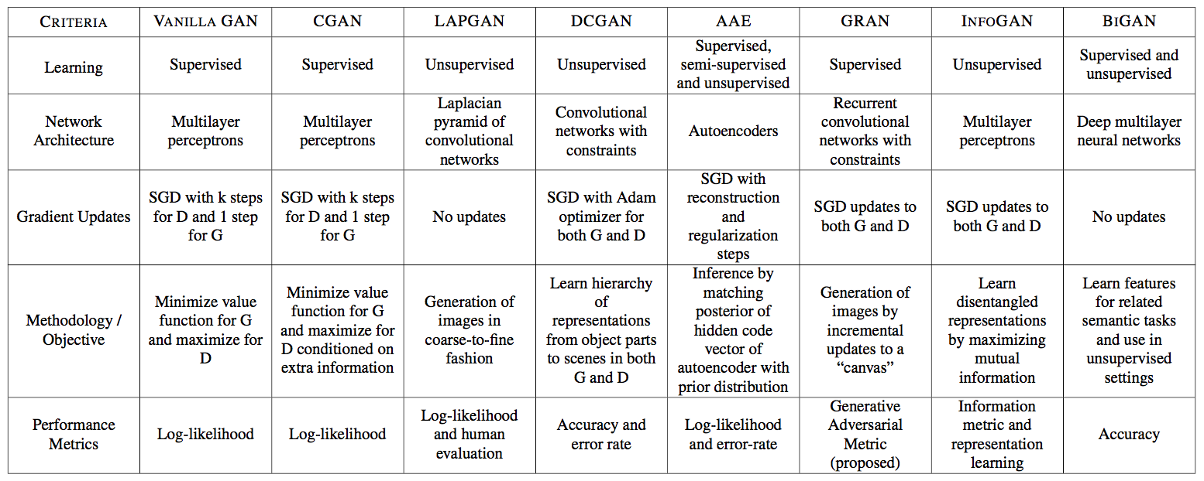
Variety of GAN Models

Slide 12
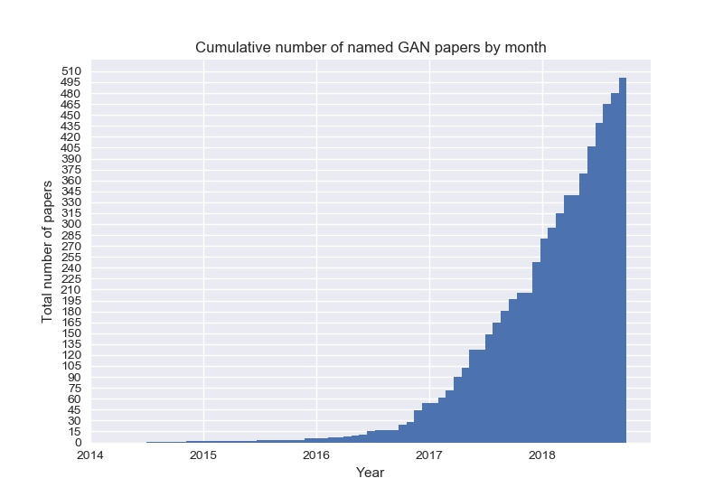
The GAN Zoo
GAN
ACGAN
BGAN
CGAN
DCGAN
EBGAN
fGAN
GoGAN
……
$$α β γ$$

Slide 13
Outline
Introduction to Generative Models
Generative Adversarial Networks (GANs)
Deep Convolutional GANs
Conditional GANs

Slide 14
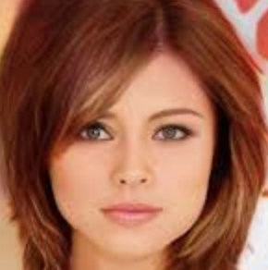
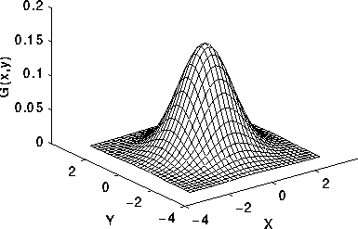
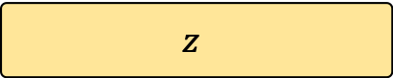
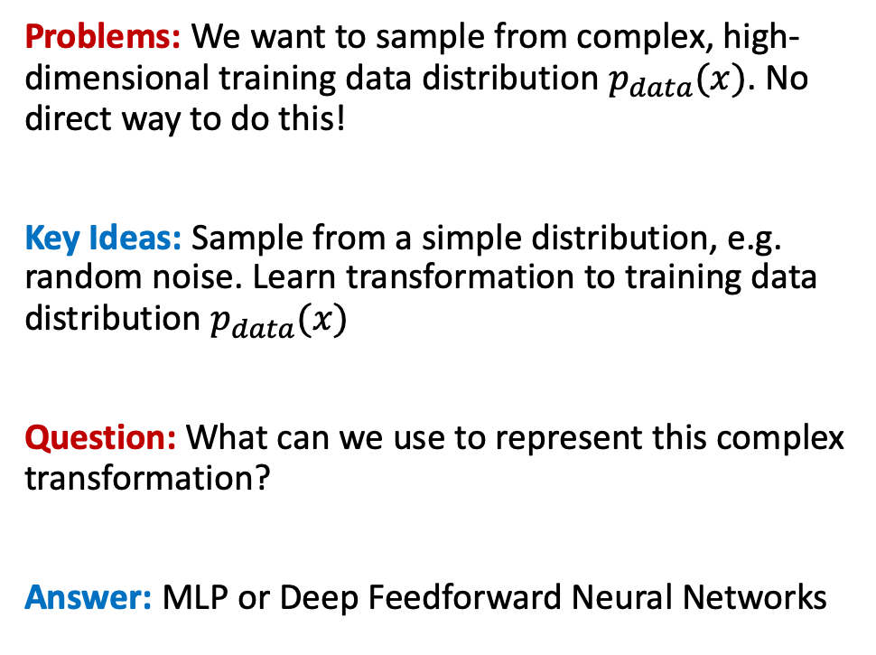
Generative Adversarial Networks
Problems: We want to sample from complex, high-dimensional training data distribution $p_{data}(x)$. No direct way to do this!
Key Ideas: Sample from a simple distribution, e.g. random noise. Learn transformation to training data distribution $p_{data}(x)$
Question: What can we use to represent this complex transformation?
Answer: MLP or Deep Feedforward Neural Networks
Output: Generated sample
from training distribution
Generator
(Neural Network)
p(z)
Input: Random Noise
$$z$$

Slide 15
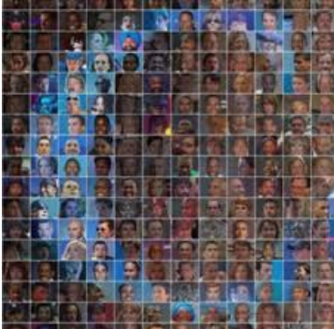
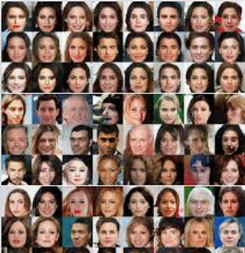
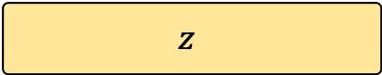
Generative Adversarial Networks
Output: Scalar
[Synthetic (0), Real (1)]
Problems: How to train generator network?
Key Ideas: Compete two NNs in two-player minimax game
Generator Network (G)
Tries to mimic example from training dataset, which sampled from “unknown” true data distribution. It takes noise z as input and generate synthetic samples.
Discriminator Network (D)
Receive samples from both G and training data (but it is not told where the sample comes from) and predict whether it is a data sample or synthetic.
D trained to make accurate predictions, and G is trained to output samples that fool the discriminator.
Discriminator Network (D)
Synthetic Faces
(generated)
Input: Real Images
(CelebA dataset)
Generator Network (G)
Input: Random Noise
$$z$$
Notes:
The basic idea of GANs is to set up a game between two players. One of them is called the generator. The generator creates samples that are intended to come from the same distribution as the training data. The other player is the discriminator. The discriminator examines samples to determine whether they are real or fake.
The two players in the game are represented by two functions, each of which is differentiable both with respect to its inputs and with respect to its parameters. Both players have cost functions that are defined in terms of both players’ parameters in adversarial setting.
Because each player’s cost depends on the other player’s parameters, but each player cannot control the other player’s parameters, this scenario is most straightforward to describe as a game rather than as an optimization problem. The solution to an optimization problem is a (local) minimum, a point in parameter space where all neighboring points have greater or equal cost. The solution to a game is a Nash equilibrium.
The generator The generator is simply a differentiable function G. When z is sampled from some simple prior distribution, G(z) yields a sample of x drawn from pmodel. Typically, a deep neural network is used to represent G.
The GAN framework pits two adversaries against each other in a game. Each player is represented by a differentiable function controlled by a set of parameters. Typically these functions are implemented as deep neural networks.

Slide 16
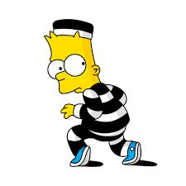

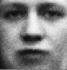



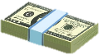
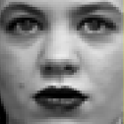
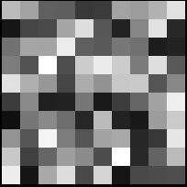
GAN Analogy: Counterfeit vs Police Game
Discriminative Model D
Generative Model G
IT’S FAKE MONEY!
…
…
…
…
IT’S REAL MONEY!
…
…
p(z)
…
…
Sample x
Random noise z
Source: NIPS 2016 Tutorial on GAN

Slide 17
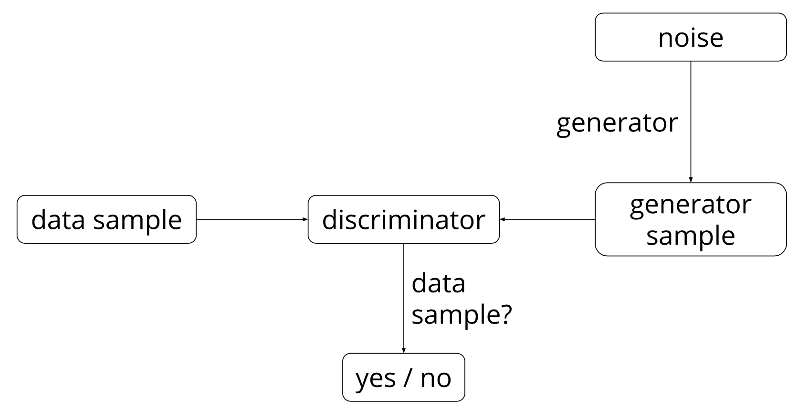
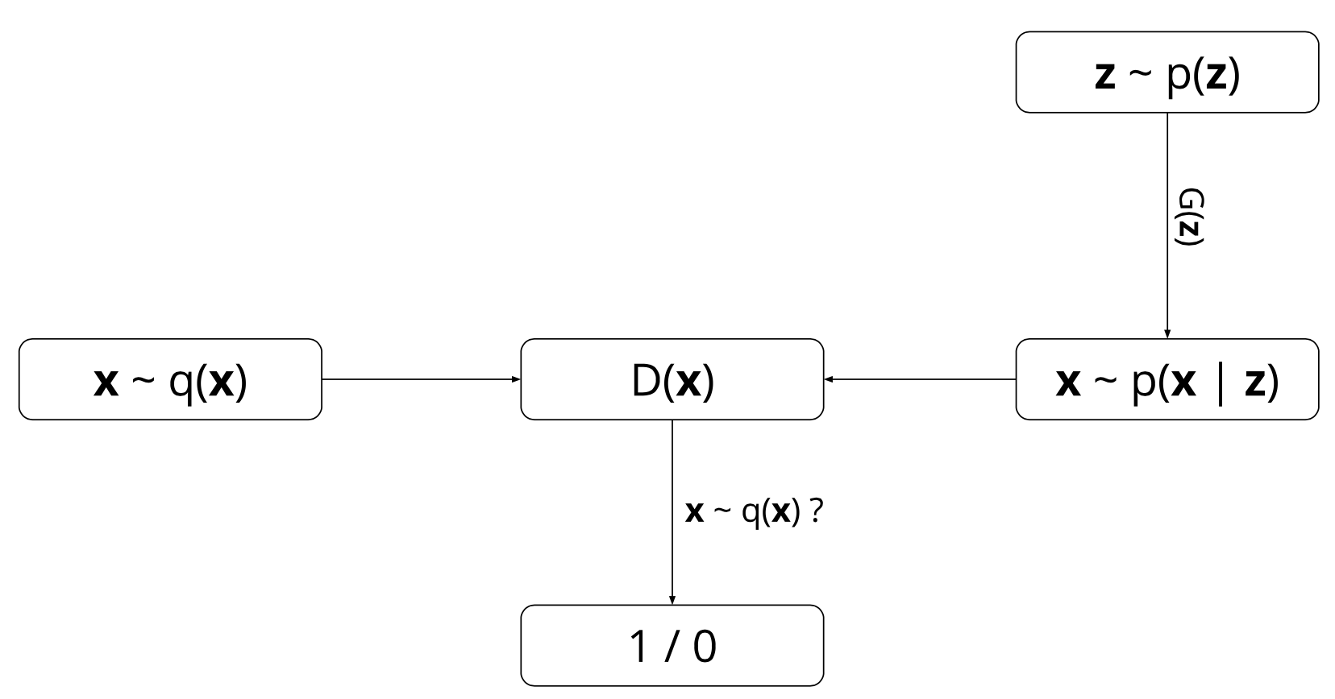


GAN Probabilistic View
GAN Models
Two marginal distributions are defined:
q(x) : the data marginal distribution (unknown)
p(x) : the model marginal distribution,
GAN operates as following:
G: sampling z ~ p(z) then sampling x ~ p(x|z)
D: receive x ~ q(x), outputs prediction
D outputs likelihood in (0,1) of real image q(x)
Learnable minimax objective function of D and G is:
Probabilistic View
Discriminator output for real data x
$$p\left(x\right)= \int{p\left(z\right)p\left(x | z\right)dz}$$
Discriminator output for fake data G(z)

Slide 18


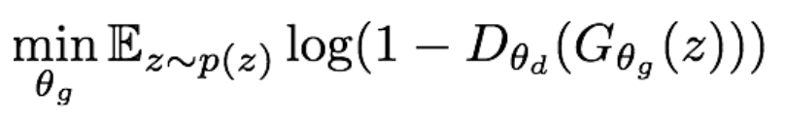
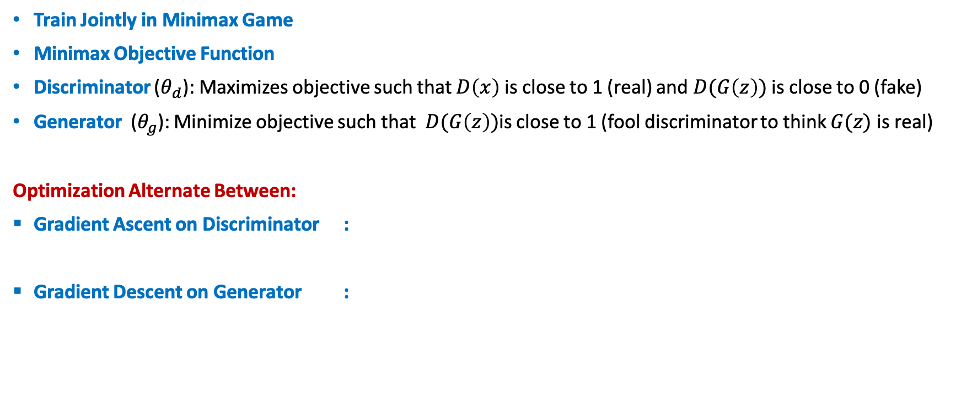
Training Minimax GANs: Two-Player Game
Train Jointly in Minimax Game
Minimax Objective Function
Discriminator ($θ_{d}$): Maximizes objective such that $D\left(x\right)$ is close to 1 (real) and $D(G\left(z\right))$ is close to 0 (fake)
Generator ($θ_{g}$): Minimize objective such that $D(G\left(z\right))$is close to 1 (fool discriminator to think $G(z)$ is real)
Optimization Alternate Between:
Gradient Ascent on Discriminator :
Gradient Descent on Generator :
Notes: Jointly training two networks is challenging, can be unstable.
Choosing objectives with better loss landscapes helps training, is an active area of research.
Notes:
The game plays out in two scenarios. In one scenario, training examples x are randomly sampled from the training set and used as input for the first player, the discriminator, represented by the function D. The goal of the discriminator is to output the probability that its input is real rather than fake, under the assumption that half of the inputs it is ever shown are real and half are fake. In this first scenario, the goal of the discriminator is for D(x) to be near 1. In the second scenario, inputs z to the generator are randomly sampled from the model’s prior over the latent variables. The discriminator then receives input G(z), a fake sample created by the generator. In this scenario, both players participate. The discriminator strives to make D(G(z)) approach 0 while the generative strives to make the same quantity approach 1. If both models have sufficient capacity, then the Nash equilibrium of this game corresponds to the G(z) being drawn from the same distribution as the training data, and D(x) = 1/2 for all x.
The training process consists of simultaneous SGD. On each step, two minibatches are sampled: a minibatch of x values from the dataset and a minibatch of z values drawn from the model’s prior over latent variables. Then two gradient steps are made simultaneously. In both cases, it is possible to use the gradient-based optimization algorithm of your choice. Adam (Kingma and Ba, 2014) is usually a good choice. Many authors recommend running more steps of one player than the other, but as of late 2016, the author’s opinion is that the protocol that works the best in practice is simultaneous gradient descent, with one step for each player.

Slide 19
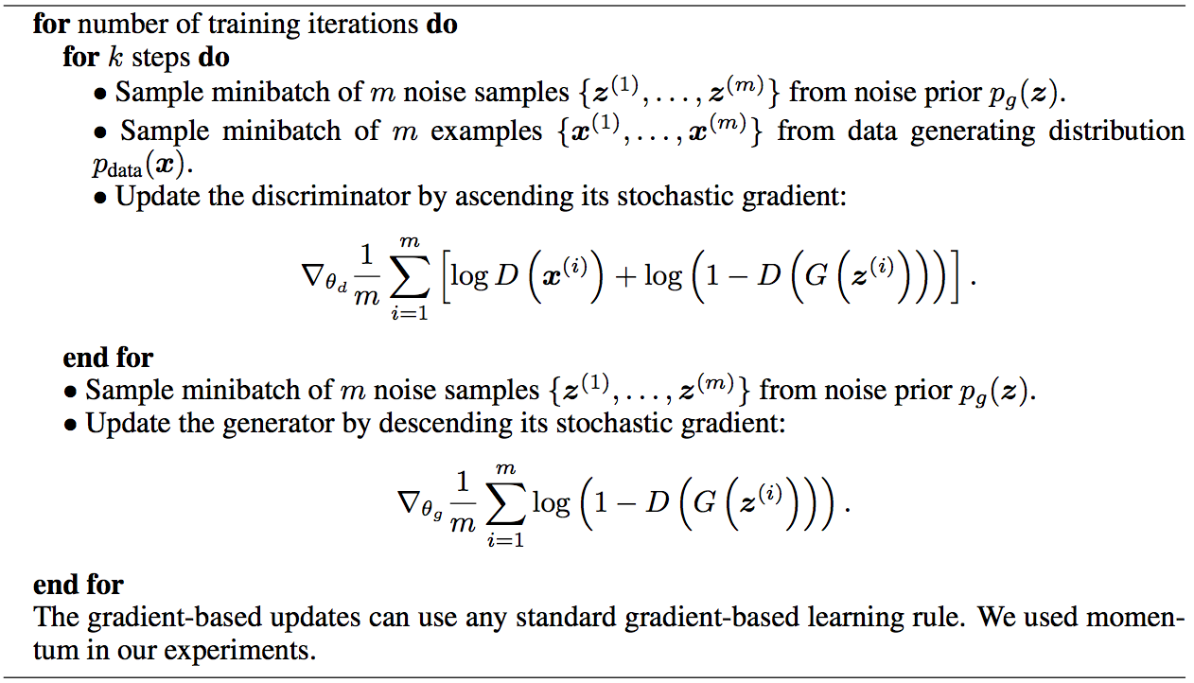
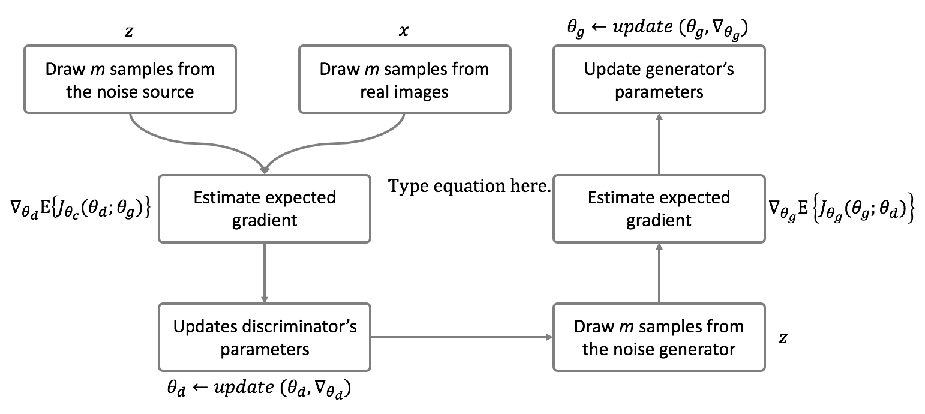
Training MM-GANs: Algorithm
Some find k=1 more stable, others use k > 1, no best rule.
Recent work (e.g. Wasserstein GAN) alleviates this problem, better stability!

Slide 20
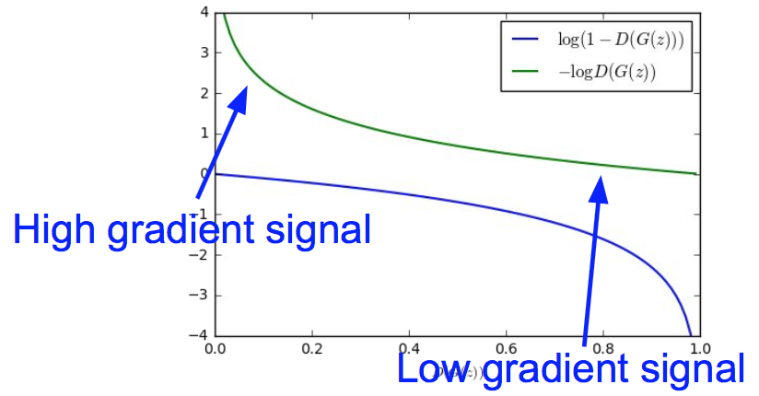
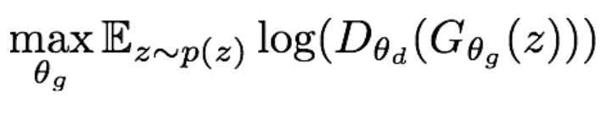
Non-Saturating GANs: NS-GAN Optimization
Optimizing the generator objective does not work well!
Gradient signal dominated by region where sample is already good
When sample is likely fake, want to learn from it to improve generator. But gradient in this region is relatively flat!
Instead of minimizing likelihood of discriminator being correct, now maximize likelihood of discriminator being wrong.
Standard in practice: Same objective of fooling discriminator, but now higher gradient signal for bad samples => works much better!
Gradient Ascent on Generator with Different Objective:

Slide 21
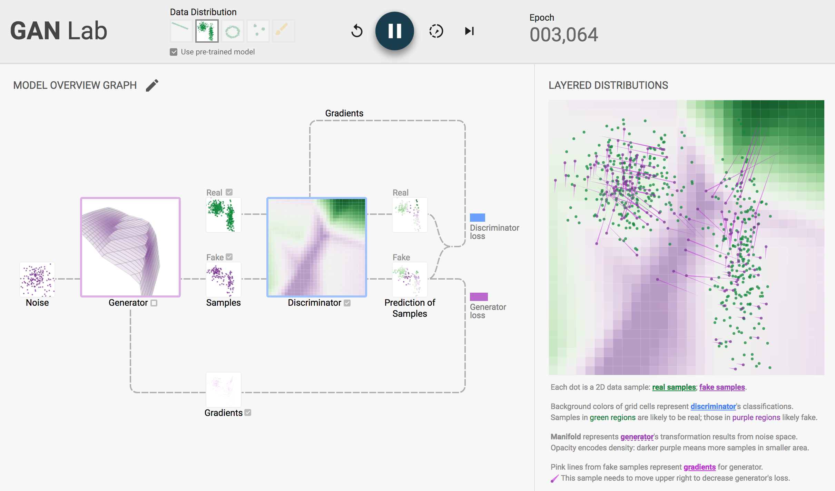
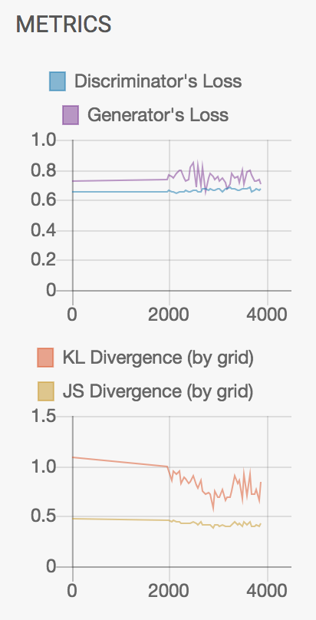
GAN Lab Animation
Source: https://poloclub.github.io/ganlab/

Slide 22
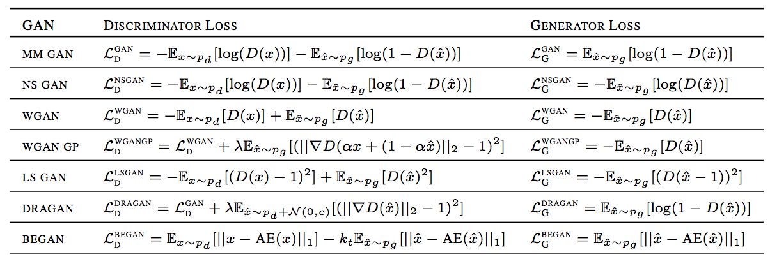
Variety of GAN Objectives
Note: We will use variant of WGAN models in many cases

Slide 23
Outline
Introduction to Generative Models
Generative Adversarial Networks (GANs)
Deep Convolutional GANs
Conditional GANs

Slide 24
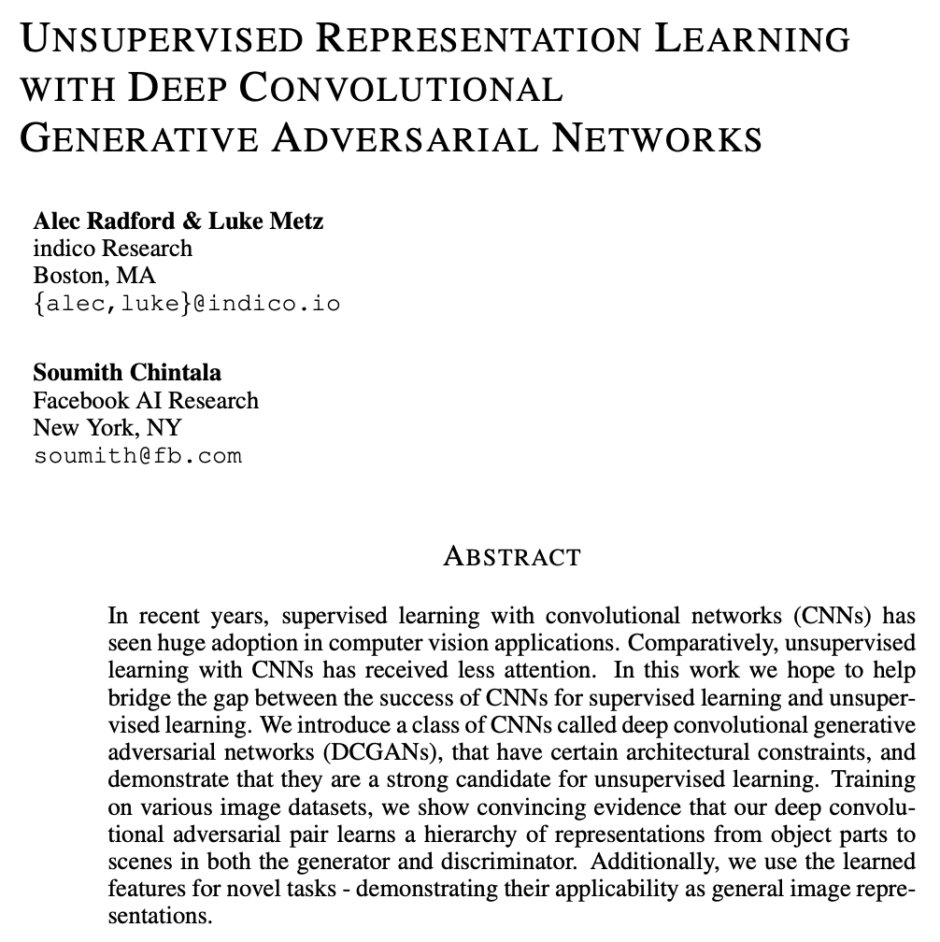
Deep Convolutional GANs
A convolutional neural network (CNN) is neural architecture that performs well for visual image analysis. The hidden layers of a CNN typically consist of a series of convolutional layers that convolve with a multiplication or other dot product. The activation function is commonly ReLU or LeakyReLU, and is subsequently followed by additional convolutions such as pooling layers, fully connected layers and normalization layers.
DCGAN Neural Architecture
Replace any pooling layers with strided convolutions in D and fractional-strided convolutions in G.
Use batch normalization in both G and D
Remove fully connected hidden layers for deeper architectures.
Use ReLU activation in generator for all layers except for the output, which uses Tanh.
Use LeakyReLU activation in the discriminator for all layers.

Slide 25
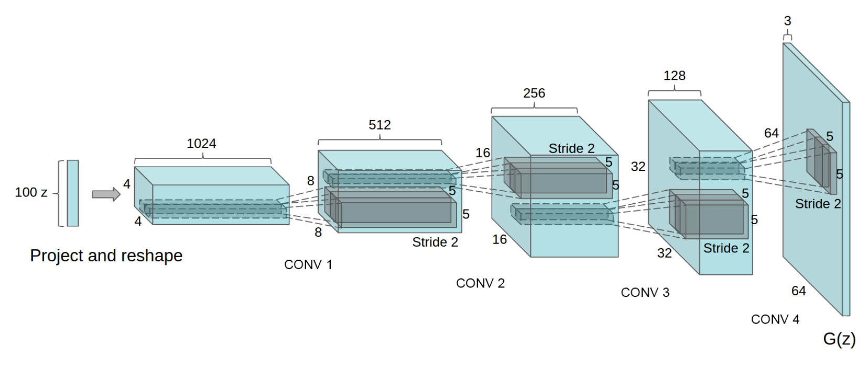
DCGAN Architecture
Generator neural architecture for DCGAN. A 100 dimensional uniform distribution z is projected to a small spatial extent convolutional representation with many feature maps. A series of four fractionally-strided convolutions then convert this high level representation into a 64 ⇥ 64 pixel image. Notably, no fully connected or pooling layers are used.

Slide 26
Outline
Introduction to Generative Models
Generative Adversarial Networks (GANs)
Deep Convolutional GANs
Conditional GANs

Slide 27
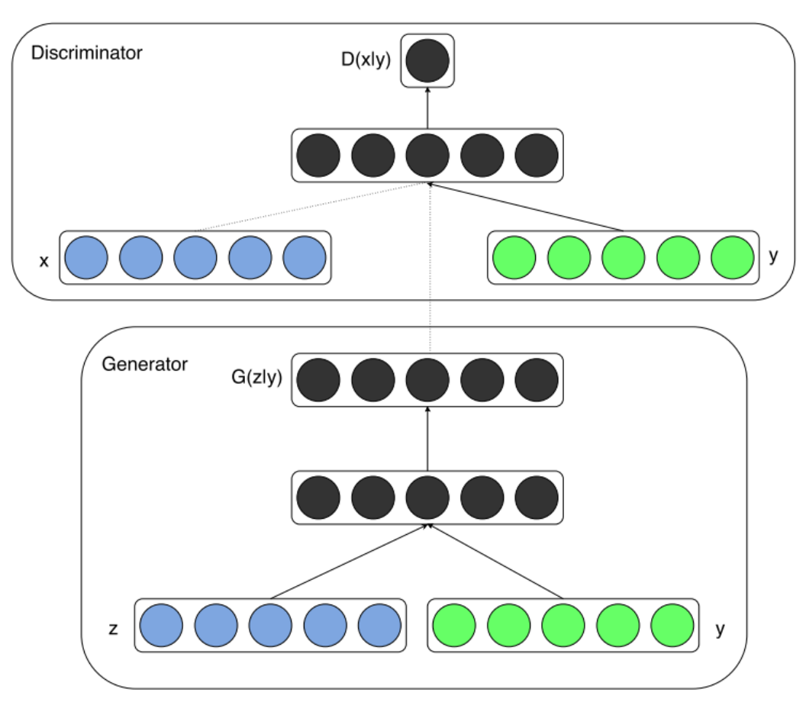

Conditional GANs
GANs can be extended to a conditional model if both G and D are conditioned on some extra information y. In this case y could be any kind of auxiliary information, such as class labels or data from other modalities.
We can perform the conditioning by feeding y into the both the G and D as additional input layer. In G the prior input noise p_{z}(z), and y are combined in joint hidden representation.
Objective function conditional GANs setting:

Slide 28
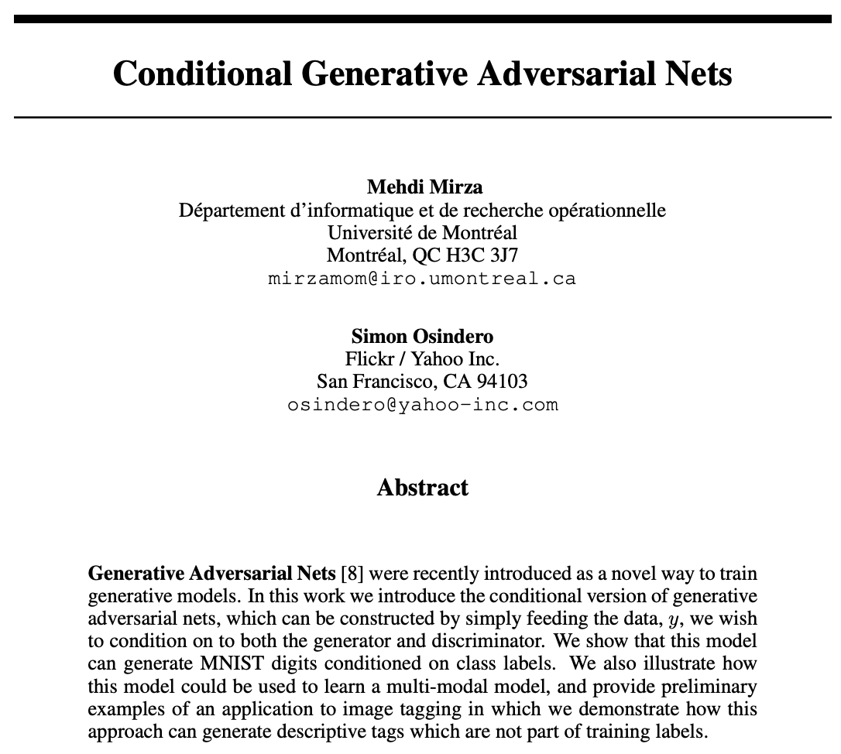
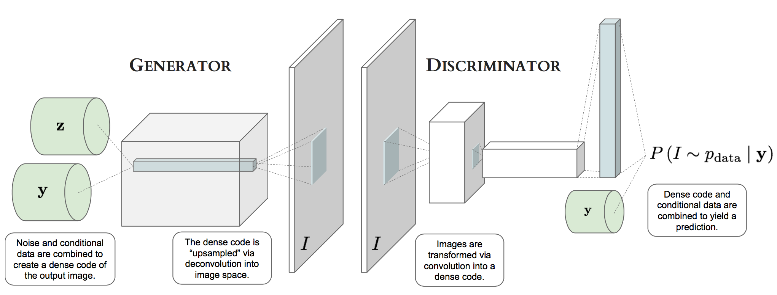
CGAN Architecture
Basic CGAN for Convolutional

Slide 29
What You Will Learn Next Week

Slide 30
Known Problems in GANs
Training GANs requires finding Nash equilibrium of a non-convex game with continuous, high dimensional parameters. A Nash equilibrium is a point such that cost functions of D and G are both at minimum. Finding Nash equilibrium is a hard research problem.
Algorithms exist for specialized cases, but hard to apply to the GANs cases, where the cost functions are non-convex, the parameters are continuous, and the parameter space is extremely high-dimensional.
Gradient descent techniques are designed to find low value of cost function, rather than to find the Nash equilibrium of minimax game. When used to seek Nash equilibrium Gradient descent is showing instability issue and may fail to converge.
Well known non-convergence issues in GANs are:
Vanishing Gradient
Mode Collapse
One way to overcome this is to use
better divergence formulation of GANs

Slide 31
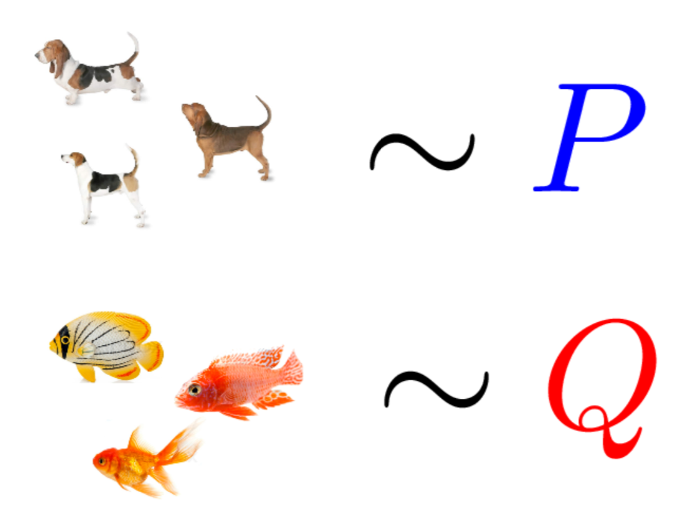
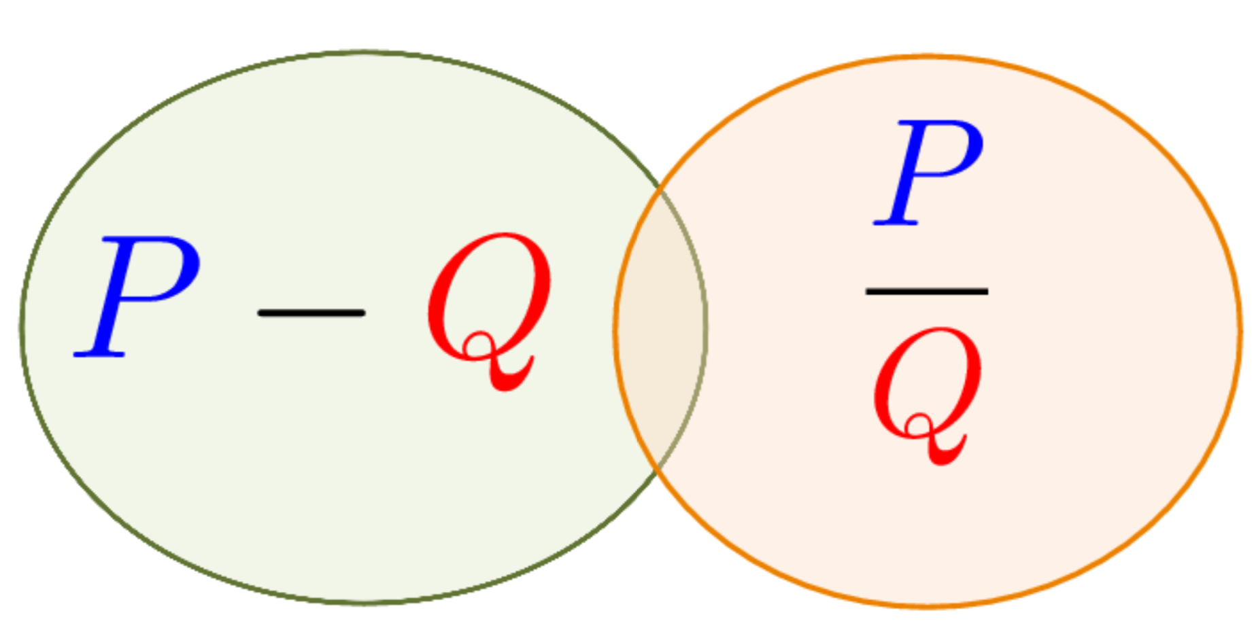
GANs Divergence Formulation
Have: Two collections of samples X; Y from unknown distributions P and Q.
Goal: Learn distinguishing features that indicate how P and Q differ.
Divergences

Slide 32
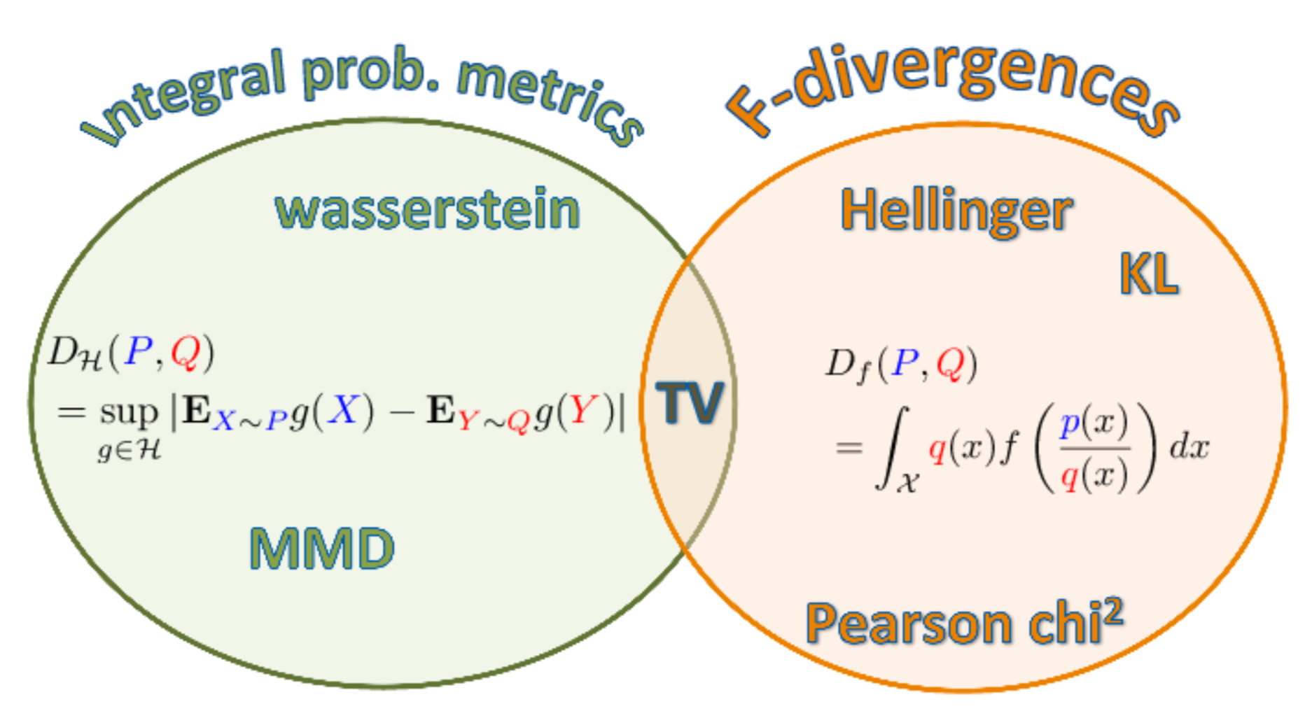
Types of Divergences
GANs offer much more flexibility in the definition of distance or divergence.
Each type of divergence gives different behaviour of convergence.

Slide 33
HOME WORK WEEK 1

Slide 34
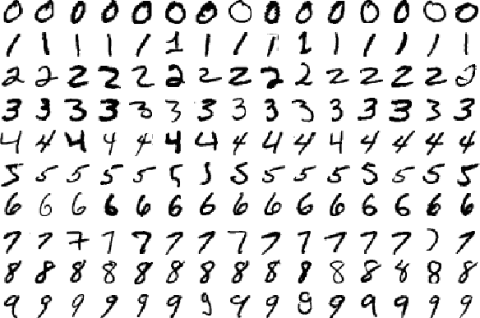
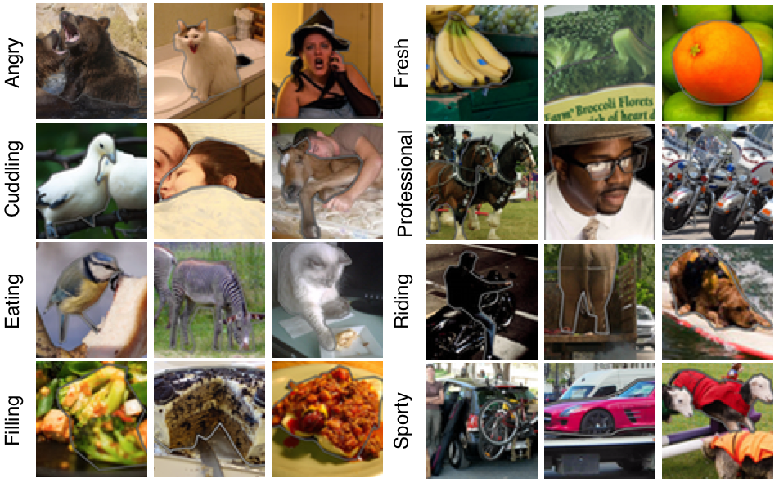
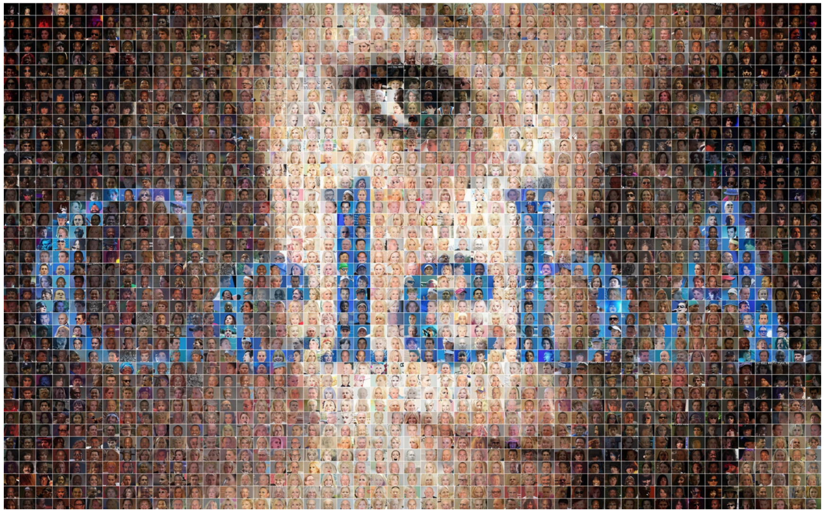
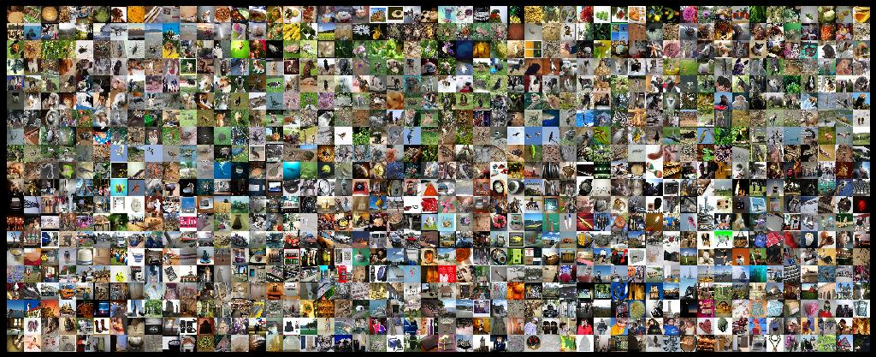
Preparing Dataset
Public Dataset (MNIST, COCO, CelebA, ImageNet)
DSC-UI-SRIN Github: https://github.com/DSC-UI-SRIN
Train your NS-GANs at Collab

Slide 35

Goodfellow et.al., 2014.
Introduced GAN initial formulation as two-player minmax game:
Initial theoretical analysis:
Global Optimality $p_{g}=p_{data}$
Train $G$ to maximize $\log\left(D\left(G\left(z\right)\right)\right)$produce better gradients instead of minimize $log⁡(1−D\left(G\left(z\right)\right))$
Simultaneous gradient descent converges if the updates are made in function (not parameter) space
Convergence of SGD only if $G$ and $D$ have enough capacity. Minimizing JSD to reach Nash Equilibrium.
Known problem:
The Helvetica scenario or mode collapse
Too many values of latent variable $z$generate same value of $x$.
Notes:
Reference:
Goodfellow, I. J., Pouget-Abadie, J., Mirza, M., Xu, B., Warde-Farley, D., Ozair, S., Courville, A., and Bengio, Y. (2014b). Generative Adversarial Networks. In NIPS’2014.

Slide 36

Ian Goodfellow, 2015.
Review of GAN and NCE (Noise-Contrastive Estimation) concepts for generative model and MLE
Both are primarily driven by a function we call distinguishability game value function:
MLE, NCE, and GANs are all asymptotically consistent, both have stationary points by minimizing a convex divergence in function space. For MLE and NCE, this stationary point is a global maximum of their objective function. For GANs it corresponds to a saddle point, a local maximum for $D$ and a local minimum $G$.
Key Insights for GAN:
GAN cannot implement MLE as it learns in the generator. A modified version of NCE related to MLE.
The existing theoretical work on GANs does not guarantee convergence in non-convex case.
Problem of non-convergence of independent SGD in the non-convex case may explain the underfitting observed in GANs and suggests the application of better algorithms for solving for the equilibrium strategies of the distinguishability game. Or how to find Nash Equilibrium in high dimension, continuous and non-convex games.
Notes:
Reference:
Goodfellow, I. J. (2014). On distinguishability criteria for estimating generative models. In International Conference on Learning Representations, Workshops Track .

Slide 37


Ian Goodfellow, NIPS 2016.
More detail tutorial on GAN initial concept. Minimizing the KL divergence between $p_{data}$ and $p_{model}$ is exactly equivalent to maximizing the log-likelihood (MLE) of the training set. Solution of GAN’s minimax (zero-sum) game is Nash Equilibrium.
Heuristic/Non-Saturating Game
Minimax: $G$ maximizes while $D$ minimizes cross-entropy so $G$ gradient vanishes/saturates!
Heuristic: Use cross-entropy minimization for $G$ to maximize $D$ being mistaken.
MLE cost – GAN using KL Divergence
Mode collapse is driven by a factor other than choice of divergence.
Top Problems in GAN:
Non-Convergence
Mode Collapse
Finding Nash Equilibrium
Quantitative Evaluation
Variance reduction techniques could be an important research area for improving the performance of GANs, especially GANs based on MLE.

